Slide 1
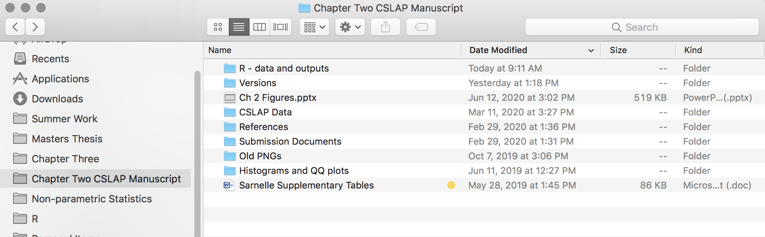
One catch-all folder for scripts, raw data, output data, figures, etc.
Main Folder for Ch. 2

Slide 2
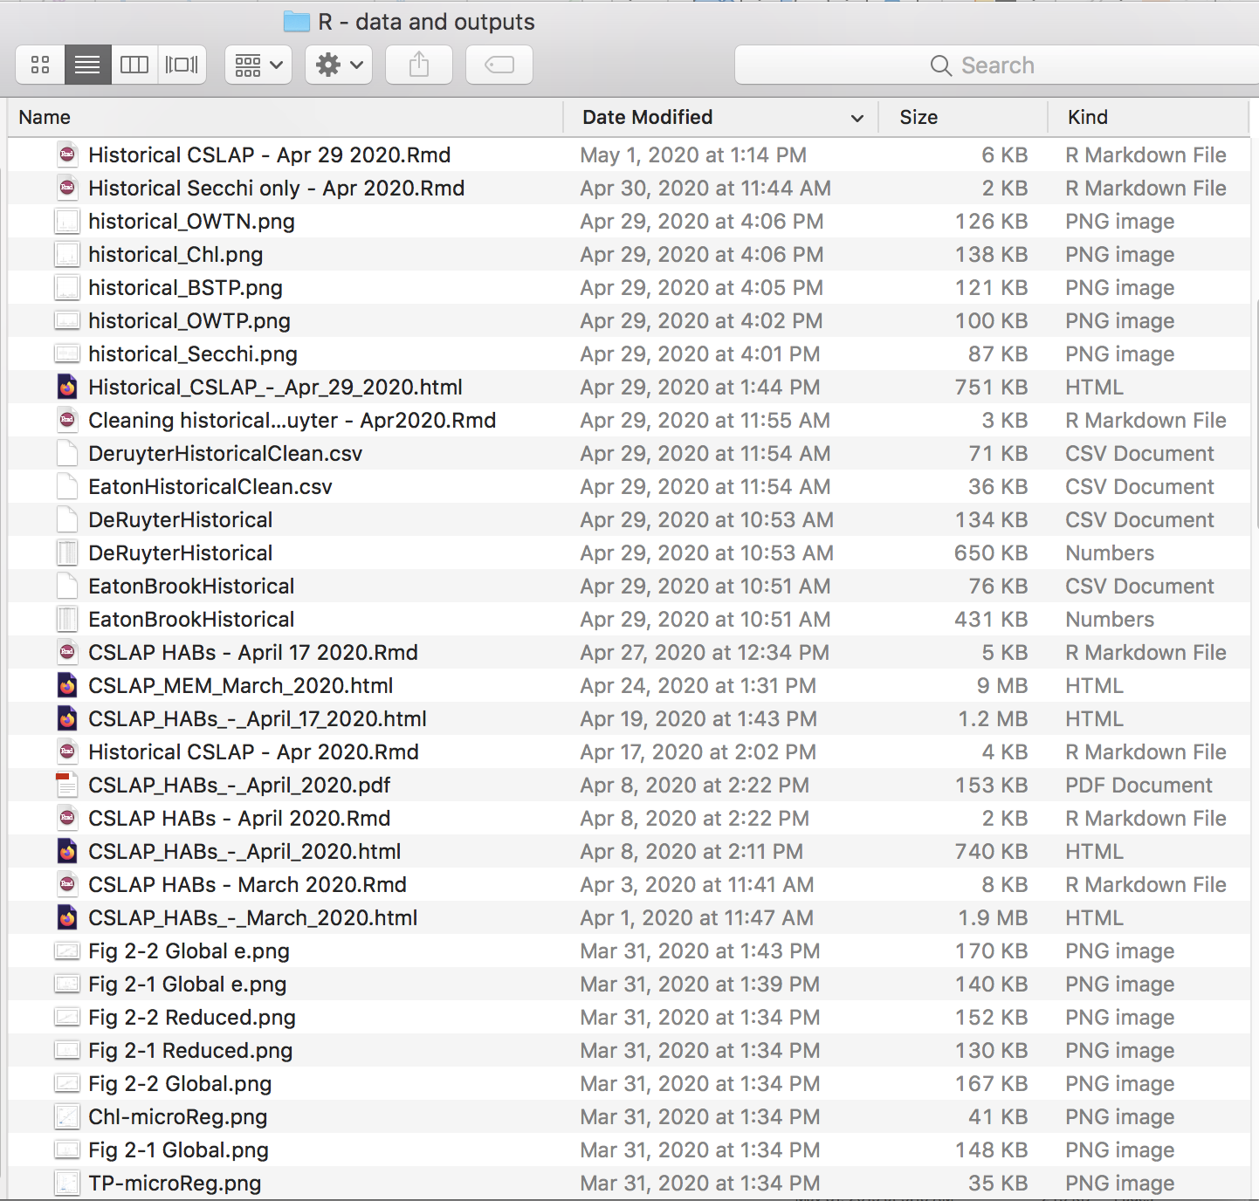
Output figures
Mixed raw data and processed data
Updated versions of same analyses

Slide 3
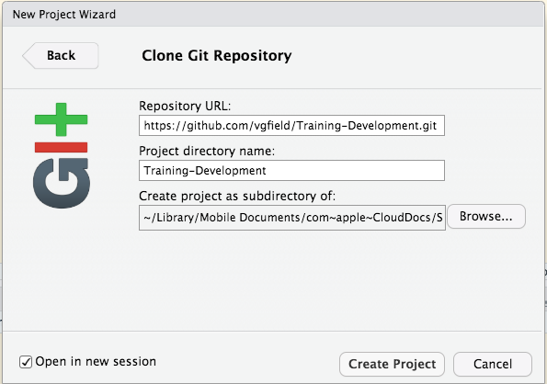
Paste URL here
This creates a new folder called “Training Development
Click this to orient yourself to the correct file pathway

Slide 4
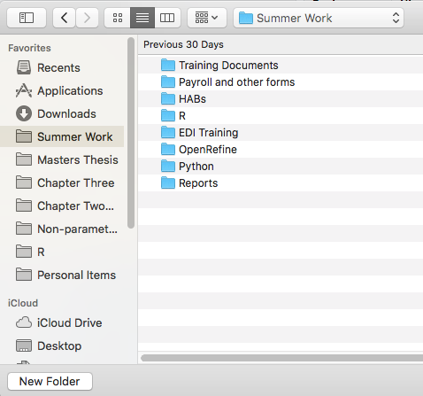
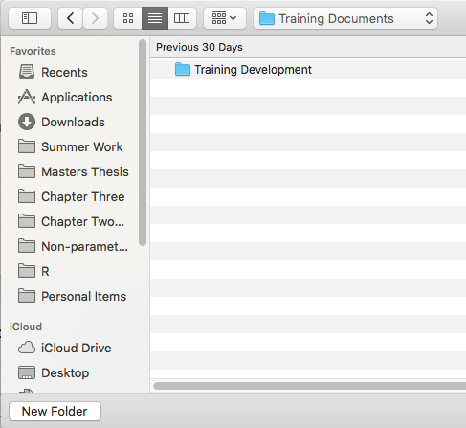

This is where I want my project to live
This folder is currently empty.
I already have main folder for Summer Work
This is the file pathway where I want to keep my new project
~/Library/Mobile Documents/com~apple~CloudDocs/Summer Work/Training Documents

Slide 5
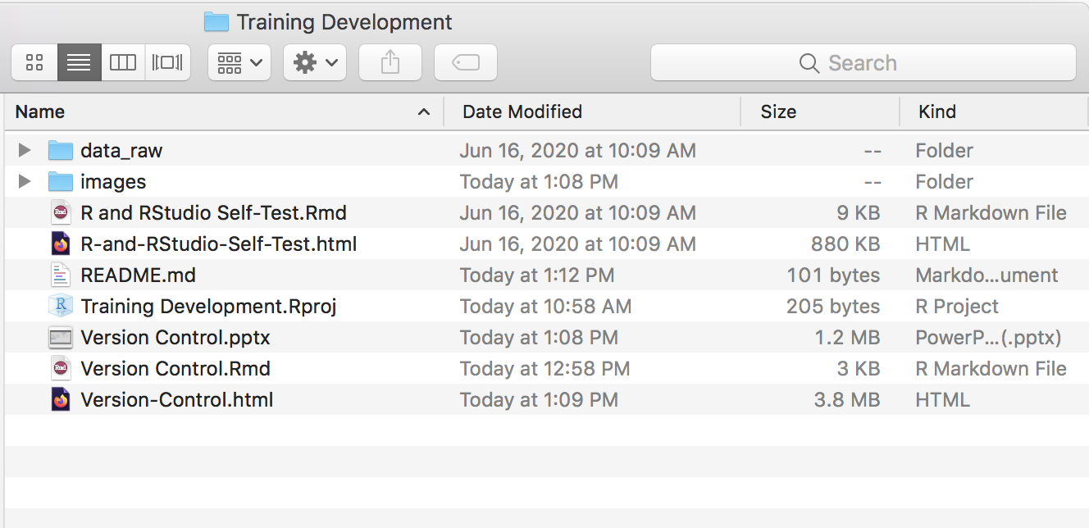
New folder
README file from GitHub
New R Project
Open the newly created folder to check out the content

Slide 6
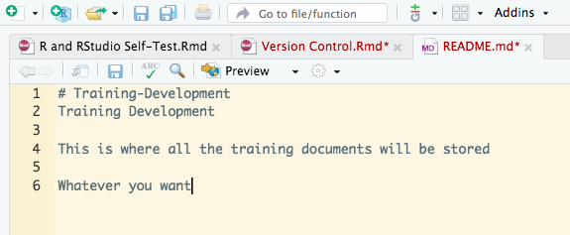
Save
Add a new line

Slide 7
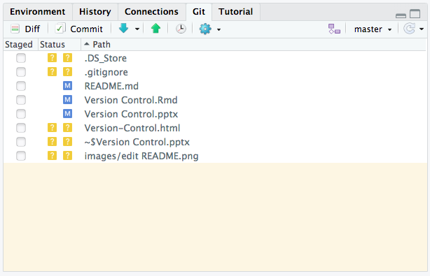
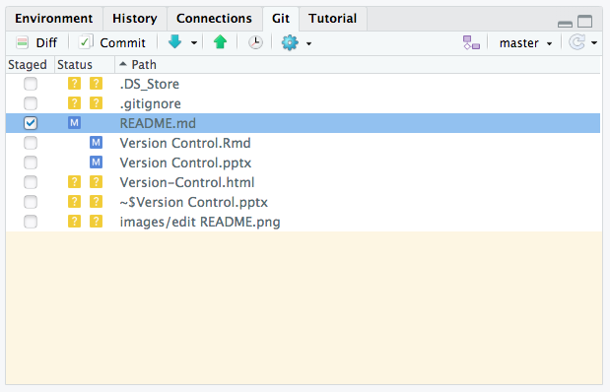
Click Commit
Here’s the change

Slide 8
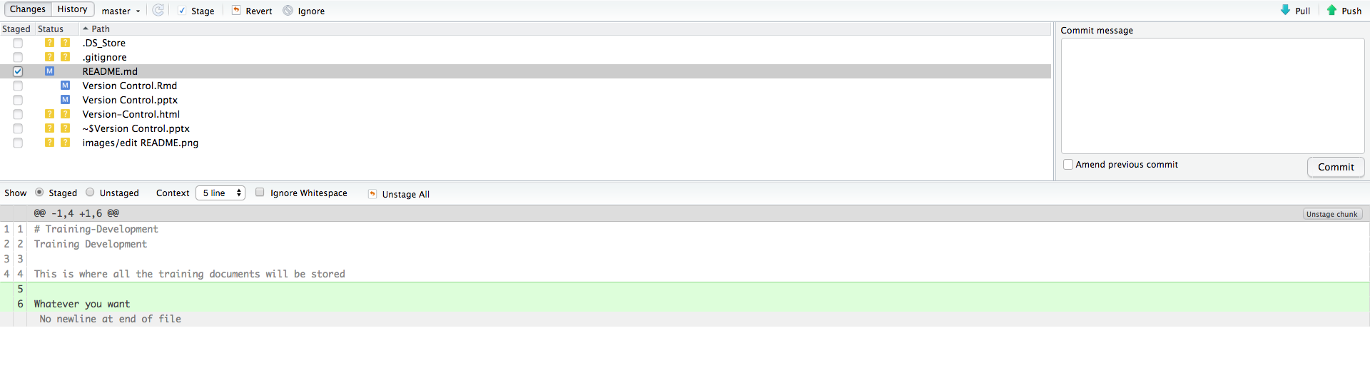
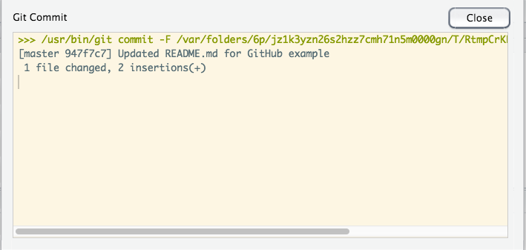
A new window opens outlining your changes
Write a commit message.
(WHY, not WHAT)
Dialogue summarizes changes

Slide 9
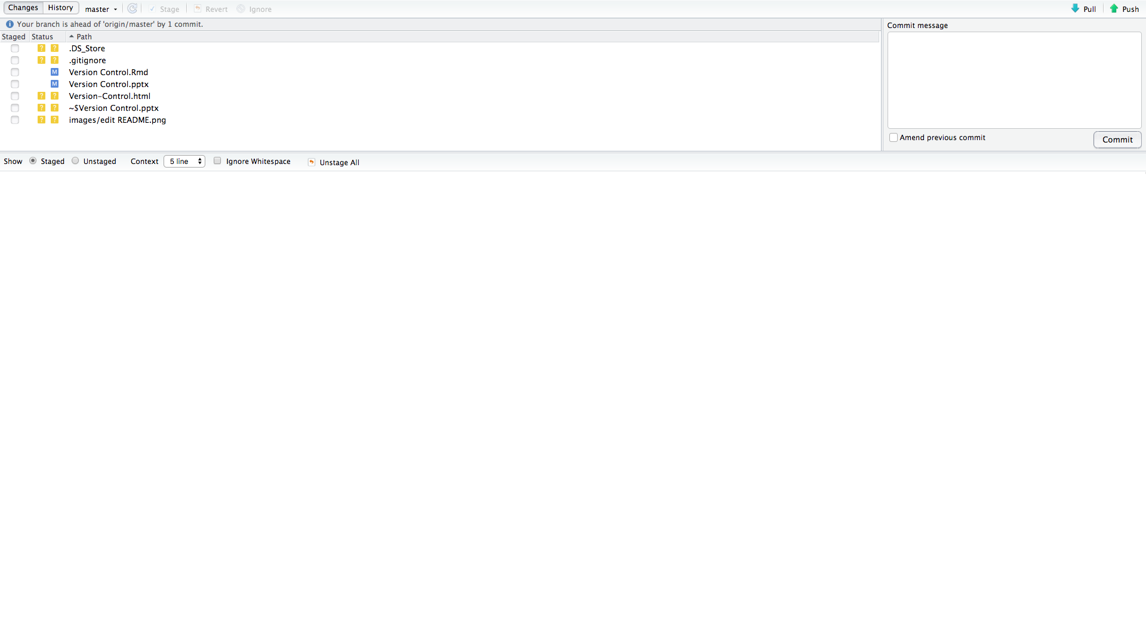
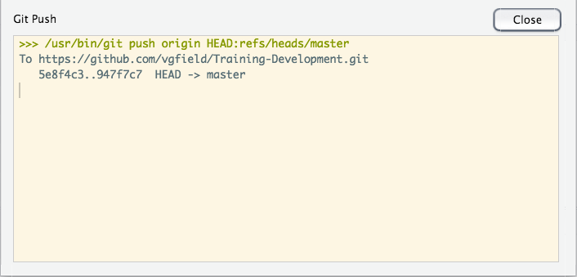
Now you need to “push” the commit

Slide 10
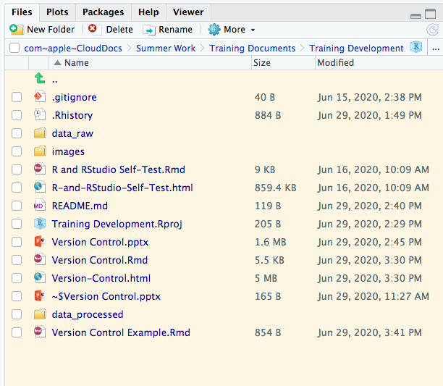
Here’s the new document

Slide 11
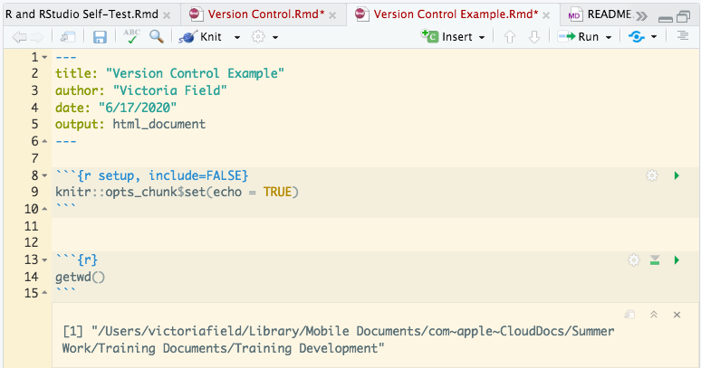
This functions gives us the file pathway for our working directory (i.e., where this RMarkdown file is saved
"/Users/victoriafield/Library/Mobile Documents/com~apple~CloudDocs/Summer Work/Training Documents/Training Development/data_raw"
Since we created new folders within this directory/folder…
We know that the pathways of the new folders are:
"/Users/victoriafield/Library/Mobile Documents/com~apple~CloudDocs/Summer Work/Training Documents/Training Development/data_processed"
"/Users/victoriafield/Library/Mobile Documents/com~apple~CloudDocs/Summer Work/Training Documents/Training Development/output_images"

Slide 12
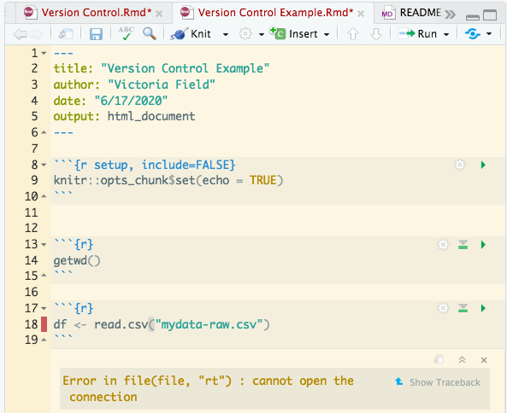
Error thrown

Slide 13
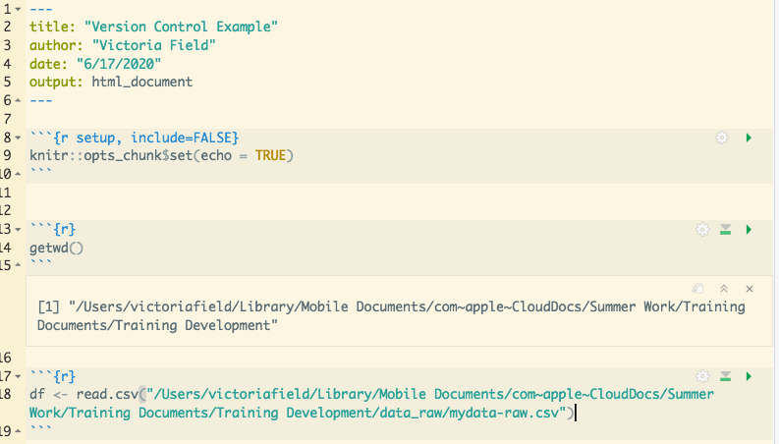
By specifying the correct pathway, we can read in the csv to Rstudio

Slide 14
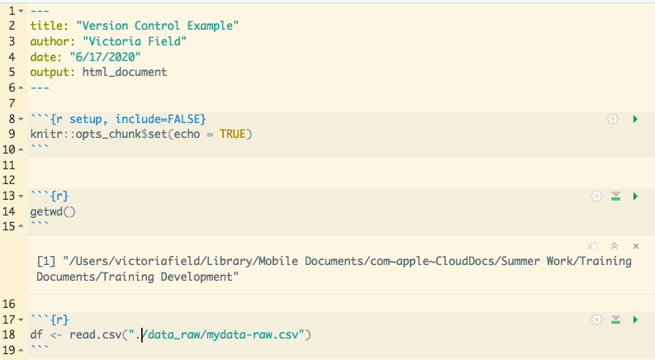
“/data_raw/my-data.csv” denotes additional doorway through with R must go to access the csv
“.” denotes working directory pathway

Slide 15
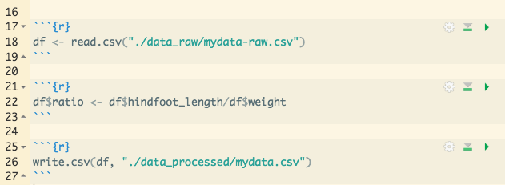
Initial R object df is a copy of “mydata-raw.csv”
Within RStudio, we manipulated df to add an additional column
Then we took the new df, and made a new csv file of it

Slide 16
We specified the correct pathway by using “.” to denote the working directory
Then specified a name for the new csv
Then added the correct folder name

